Slide 1
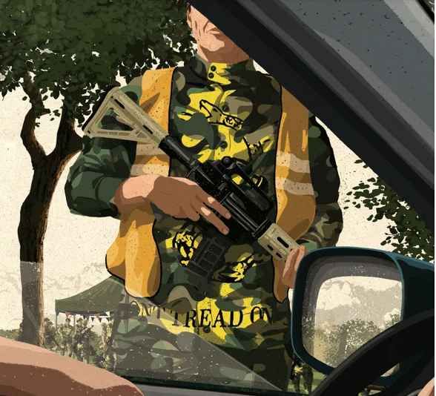

Understanding Ideologies & Groups
Part 1
Anne Speckhard, Ph.D. - Director, International Center for the Study of Violent Extremism

Slide 2
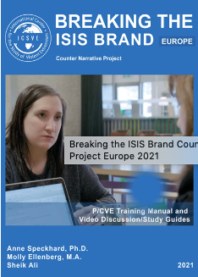
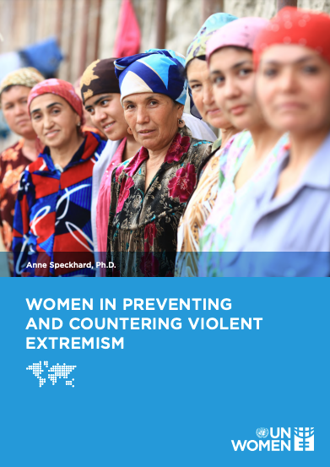
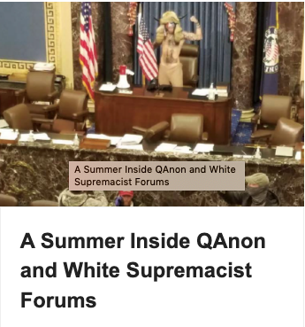
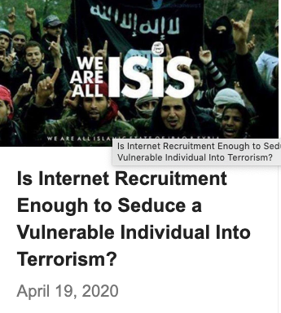
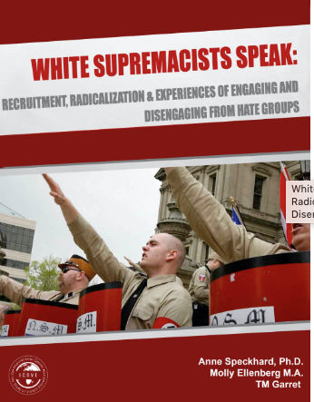
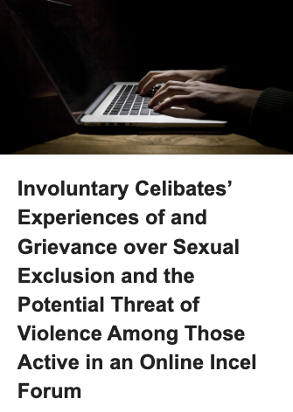
ICSVE - a think and do tank
800 + in-depth psychological interviews with terrorists, violent extremists and their family members and close associates
273 of ISIS
16 al Shabaab
51 white supremacists and anti-government militia members
Created 300 counter narrative videos – Escape Hate and Breaking the ISIS Brand
200 + Facebook campaigns for prevention
Designed the psychological and Islamic Challenge parts of the Detainee Rehabilitation Program for our 20,000+ detainees in Iraq in 2007
Consult to EU, US agencies, FBI, EU and Balkan countries, globally on prevention, rehabilitation, reintegration issues
Gender consulting, police training, researchers

Slide 3
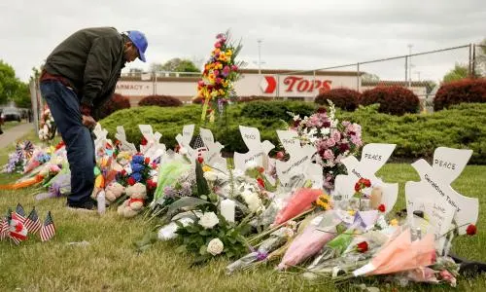
Police Responses to Terrorism and Violent Extremism ICSVE Training Outline
Monday: Understanding Ideologies and Groups: Focus on Domestic Groups
Tuesday: Understanding Ideologies and Groups: Focus on International Groups
Wednesday: How Extremists Enter Communities: Matching Vulnerabilities and Motivations with Extremism
Thursday: What to Do About Extremism When It Takes Root & Creating a Whole-of-Society, Public Health Systems-Based Response
Friday: Extremist Recruitment and Infiltration Practices in Law Enforcement

Slide 4
There is no free lunch ;)
Quiz
Notes:
Terrorists are politically motivated nonstate actors who use violence against civilians and property to instill fear and try to achieve a political goal.

Slide 5
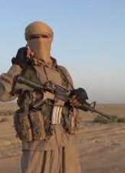
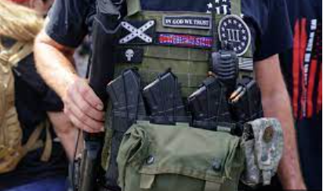
Defining Terrorism and Violent Extremism
500 definitions of terrorism.
  Terrorists are politically motivated nonstate actors who use violence against civilians and property to instill widespread fear while trying to achieve a political goal.
From the FBI and DHS:
  A “domestic violent extremist” (DVE) is defined as an individual based and operating primarily within the United States or its territories without direction or inspiration from a foreign terrorist group or other foreign power who seeks to further political or social goals, wholly or in part, through unlawful acts of force or violence dangerous to human life.
Notes:
Terrorists are politically motivated nonstate actors who use violence against civilians and property to instill fear and try to achieve a political goal.

Slide 6

Defining Targeted Violence
Targeted violence refers to violence that is premeditated and directed at specific individuals, groups, or locations with a political or ideological motive in mind. Groups that are often subject to targeted violence include racial, ethnic, or religious groups.Target groups may also be chosen on the basis of sex, sexual orientation, or gender identity.
It’s important to note however, that in many cases perpetrators arbitrarily choose specific victims of the group they wish to target.
Targeted violence is distinct from violence that is impulsive, random, or spontaneous and is often distinguished by pre-attack behaviors that suggest violence as a possible outcome.
Those behaviors, if identified and addressed, can reduce the likelihood of a targeted violence incident in your community.
Notes:
Terrorists are politically motivated nonstate actors who use violence against civilians and property to instill fear and try to achieve a political goal.

Slide 7
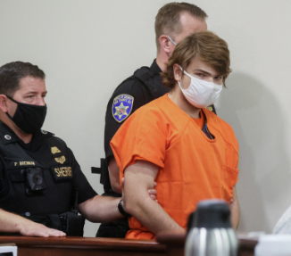
Current Domestic Violent Extremism Threat
From DHS, October 2022:
  “The FBI and DHS assessed lone offenders and small groups of individuals would continue to pose significant mitigation challenges due to their capacity for independent radicalization and mobilization and preference for easily accessible weapons.”
  While lone wolves act alone, they are rarely “lonely,” as they are most often inspired by existing groups, ideologies and social support, which they often find via the internet.
  Likewise, they often quote from and emulate the violent acts of others, hoping to exceed them in lethality of their attacks.
Notes:
Incels quote, Buffalo shooter etc.

Slide 8
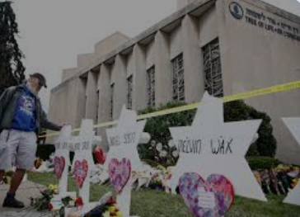
Current Domestic Violent Extremism Threat
From DHS, October 2022:
  “In 2021, the FBI and DHS assessed RMVEs [Racially Motivated Violent Extremists] advocating the superiority of the white race and anti-authority or anti-government violent extremists, specifically militia violent extremists, as presenting the most lethal threat categories.”
  “The FBI and DHS assessed RMVEs were most likely to conduct mass-casualty attacks against civilians, and militia violent extremists would typically target law enforcement and government personnel and facilities."

Slide 9
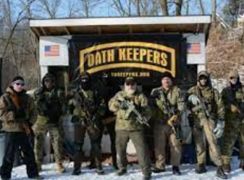
Domestic Violent Extremism Categories
Categories defined by the U.S. Government:
  Racially or Ethnically Motivated Violent Extremism
  Anti-Government or Anti-Authority Violent Extremism – usually militias
  Animal Rights/Environmental Violent Extremism
  Abortion-Related Violent Extremism
  Other, including ideologies related to religion, gender, or sexual orientation

Slide 10
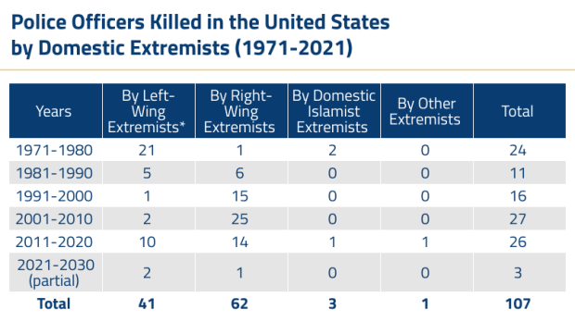

Slide 11
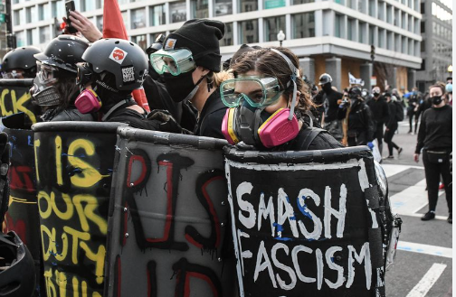
Ideologies and Conspiracies Underlying DVE Groups
Racially or Ethnically Motivated Violent Extremism
  White supremacy
  White nationalism/separatism
  Black separatism
Anti-Government or Anti-Authority Violent Extremism
  Militia movements – often gun rights/constitutional “defenders”
  Sovereign citizens – don’t believe in government
  Antifa/Jane’s Revenge – anti-fascist/abortion rights
Accelerationism - anarchists
Environmentalism
Anti-Abortion

Slide 12
Domestic Violent Extremist Groups by Categories

Slide 13
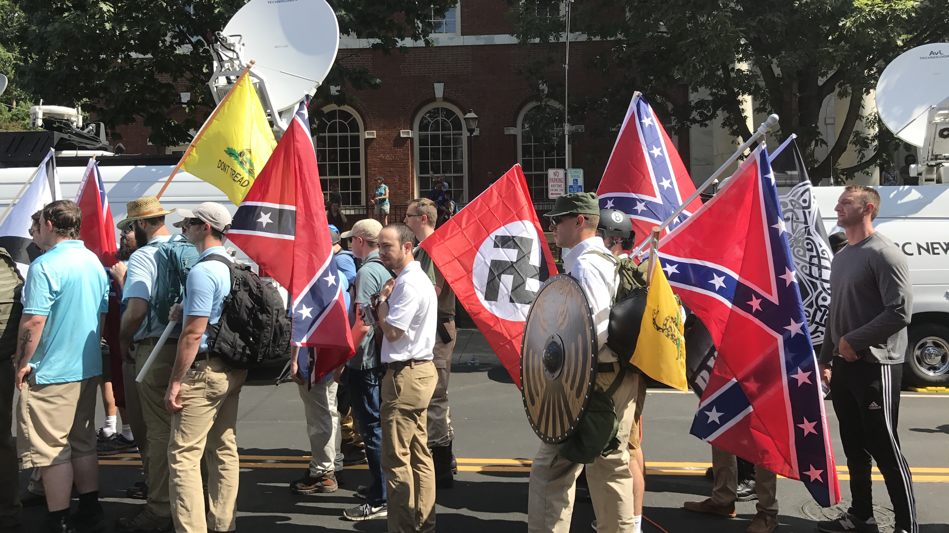
White Supremacy

Slide 14


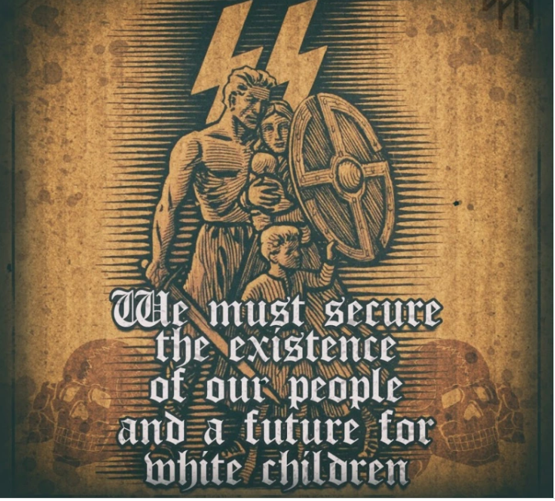
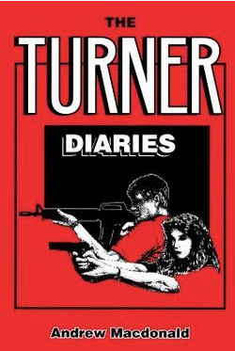









White Supremacists
Belief systems vary:
  Christian Identity
  Racist Odinism
  Neo-Nazism
  Conspiracy theories
Core tenets:
  White racial superiority
  Antisemitism
  White replacement/White genocide
  RaHoWa
  Homophobia/Transphobia

Slide 15

Some Numbers to Recognize
14 Words
88 – Heil Hitler
18 – Adolph Hitler
5 – I have nothing..
“We must secure the existence of our people and a future of White children.” David Lane
Heil Hitler
Adolph Hitler
“I have nothing to say” Alex Curtis

Slide 16
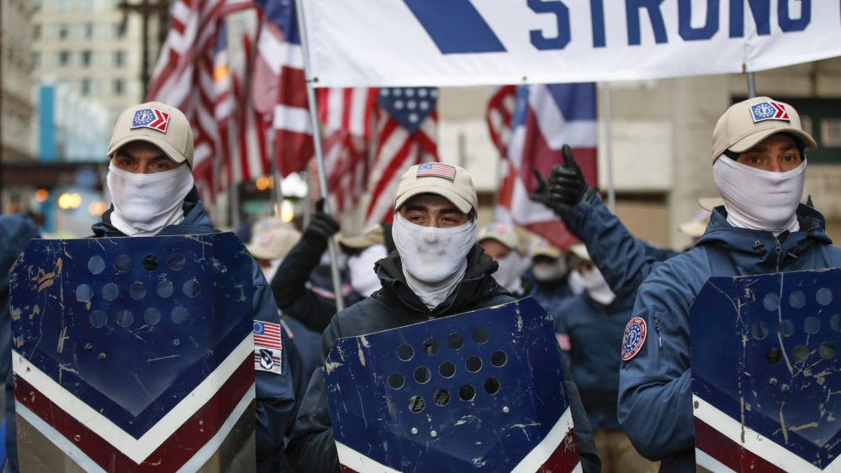
White Nationalism

Slide 17
Proud Boys
Core tenets:
  Western chauvinism
    Islamophobic
    Anti-immigrant
  Anti-feminist, transphobic, homophobic
  Oppose big government, drug war, political correctness

Slide 18
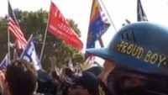
Notes:
Proud Boy gets Punched in the Face: https://www.youtube.com/watch?v=UqDE7zAqMtc&list=PLqpy96DXqN-eNRvnqVAzMdcec9wOih0XW&index=8&ab_channel=ICSVE

Slide 19
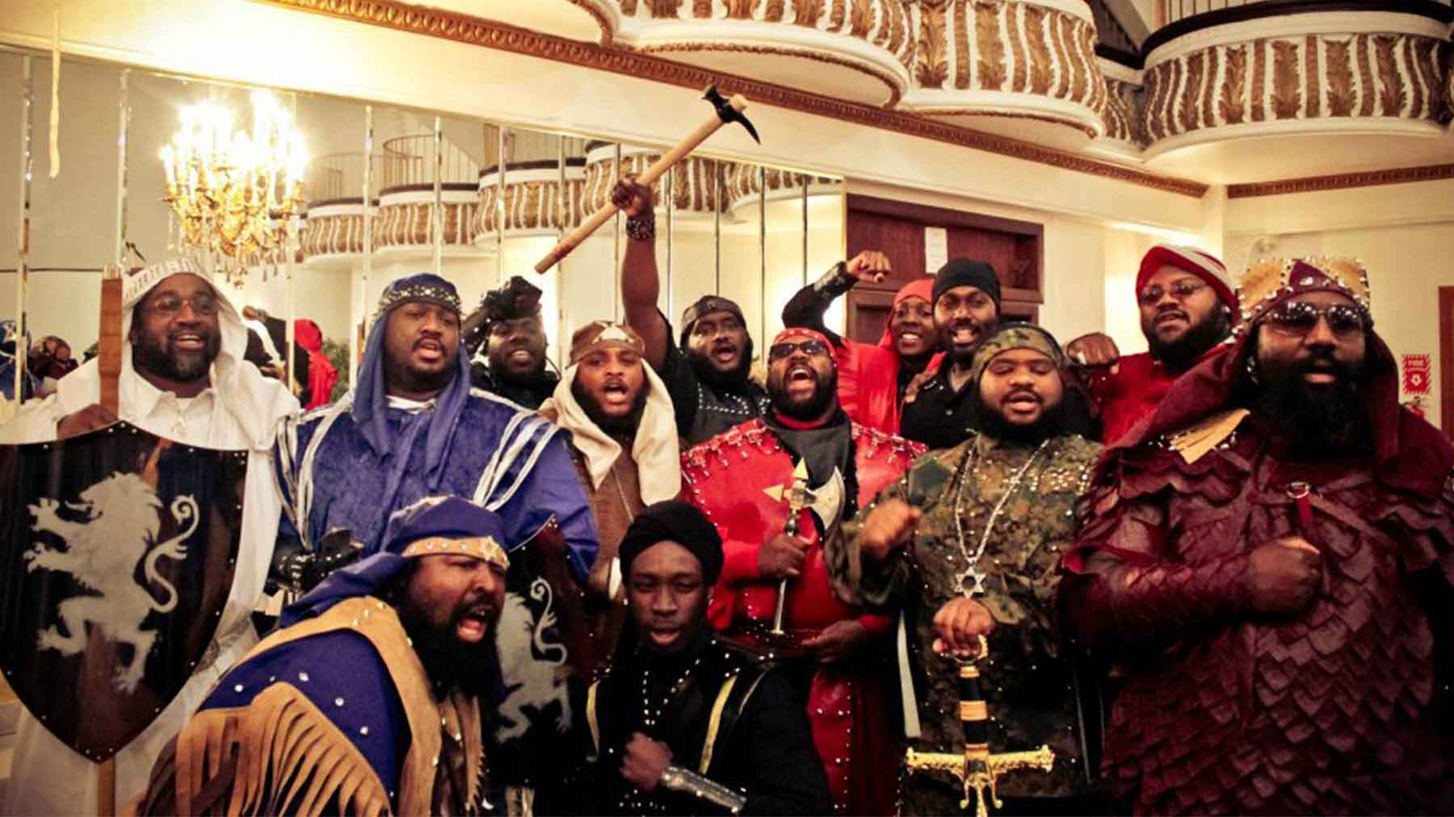
Black Separatism

Slide 20
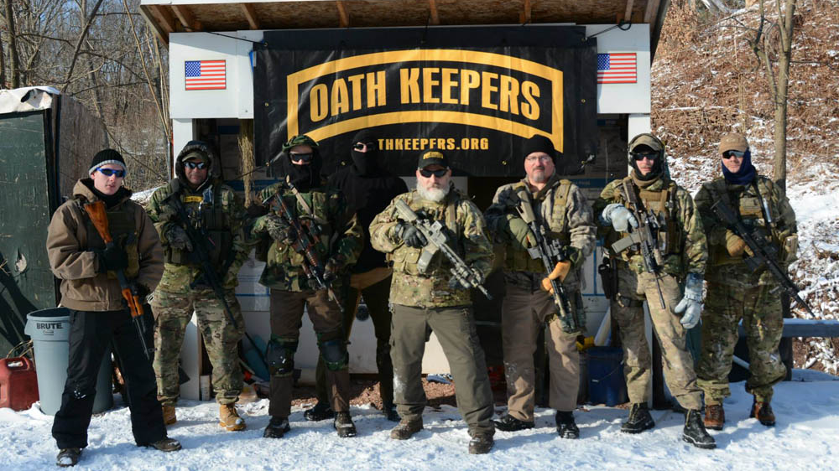
Anti-Government Militias

Slide 21

Boogaloo Bois
Core tenets:
  Aim to accelerate a second Civil War
  Explicitly oppose law enforcement
  Anti-government and not exclusively white supremacist

Slide 22


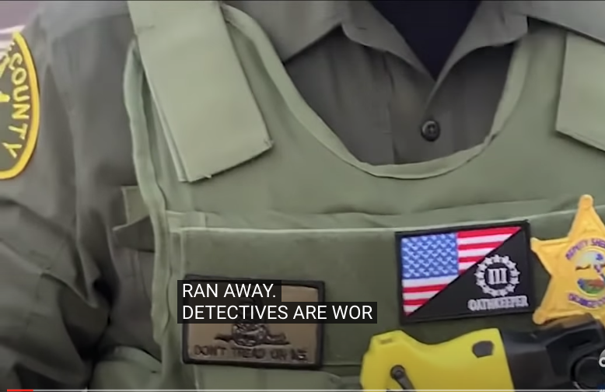
Oath Keepers
Core tenets:
  “Defenders of the Constitution”
  Use paramilitary tactics to “protect civil liberties”
  Recruiting law enforcement/military/first responders is a top priority

Slide 23
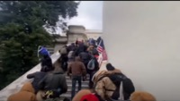
Notes:
Oath Keepers Not on our Watch: https://www.youtube.com/watch?v=_ylG549LS6g&list=PLqpy96DXqN-eNRvnqVAzMdcec9wOih0XW&index=32&ab_channel=ICSVE

Slide 24



Three Percenters
Core tenets:
  Anti-government movement “resisting tyranny”
  Focus on opposing gun control

Slide 25

Patriot Front
Core tenets:
  White separatist
  Successor to neo-fascist Vanguard America

Slide 26
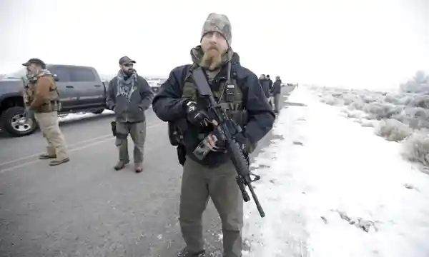
Sovereign Citizens

Slide 27
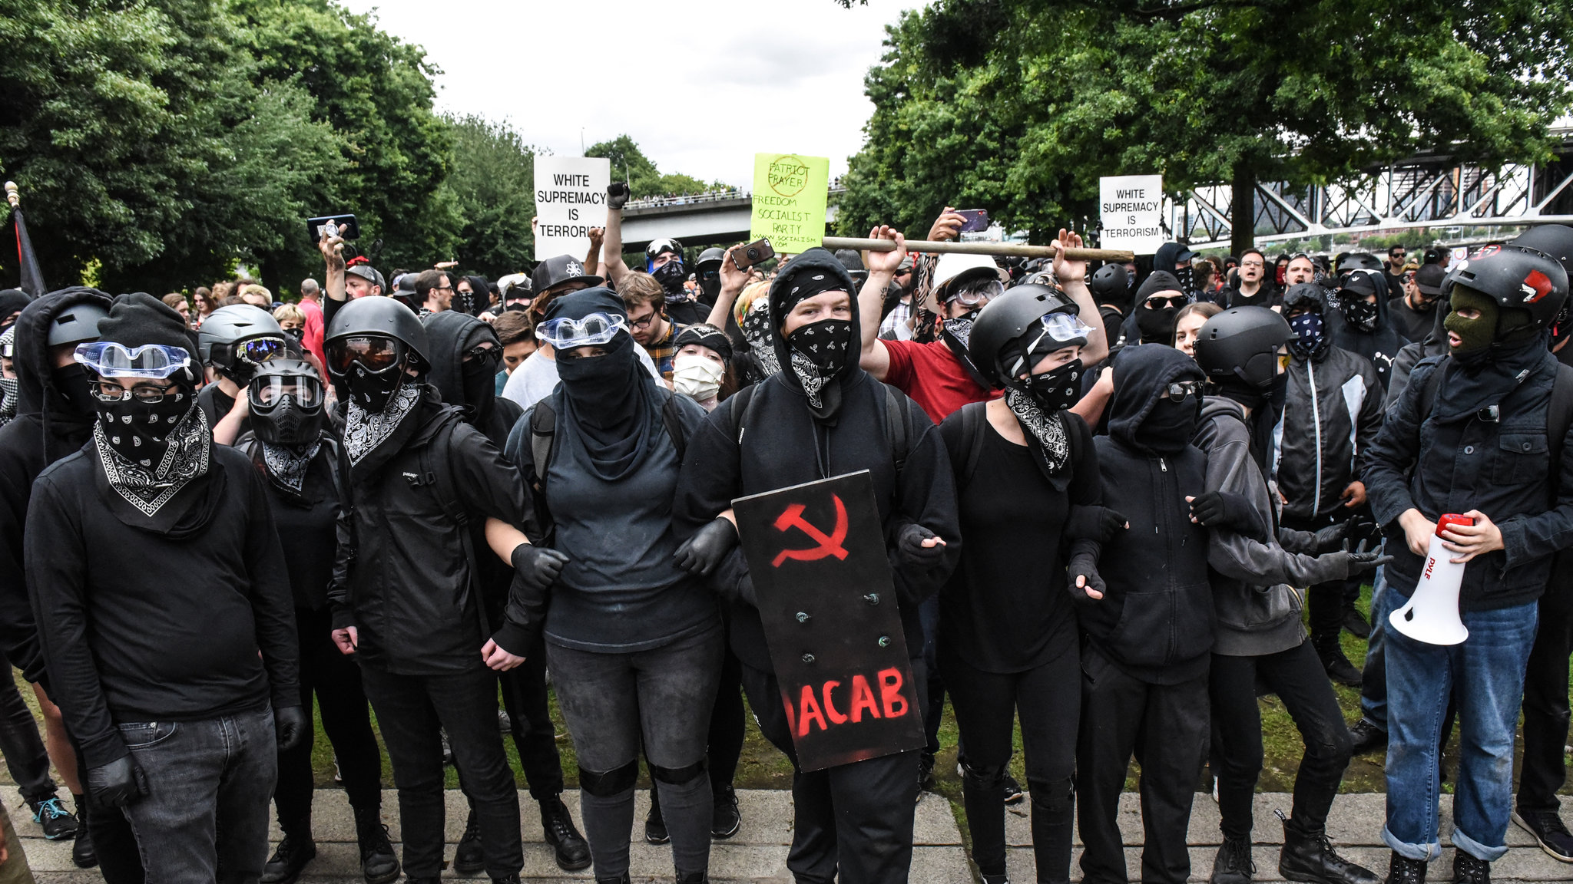
Antifa

Slide 28
Antifa
Oppose fascism but not exclusively anarchists
Violence is justified to protect oppressed groups
Property damage, infiltration, and doxxing are appropriate counter-measures to neo-fascist groups
Oppose law enforcement
No murders until one was linked in 2020.
Notes:
https://www.theguardian.com/world/2020/jul/27/us-rightwing-extremists-attacks-deaths-database-leftwing-antifa

Slide 29
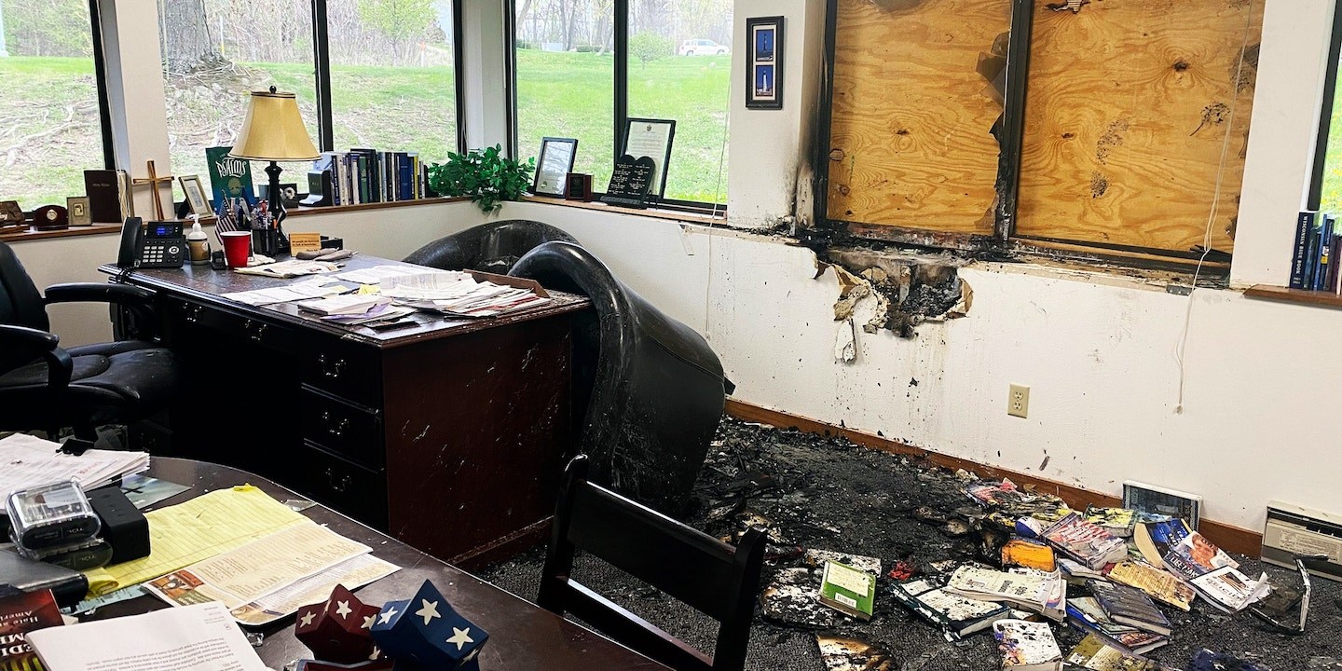
Pro-Choice/Jane’s Revenge
Pro-Choice/Jane’s Revenge

Slide 30
Environmentalism

Slide 31
Pro-Life/Anti Abortionists
Pro-Life/Anti Abortionists

Slide 32

Anti-Abortion Terrorists
Core tenets:
  Violence, property damage, and intimidation are justified to protect unborn children
  Doctors who perform abortion are committing genocide

Slide 33

Q-Anon
Core tenets:
  The United States is controlled by an elite cabal of Satanist, sex-trafficking pedophiles
    Antisemitic overtones
  The Storm & Day of Reckoning will be brought about by former President Trump and traitors will be arrested en masse and hanged

Slide 34
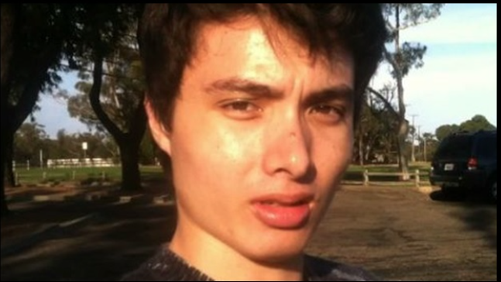
Involuntary Celibates (Incels)
  Incels – or involuntary celibates, are men sexually frustrated men who congregate and communicate almost exclusively online
  They are upset over their inability to obtain and sustain a romantic relationship and have a lot of self loathing as they initially blame their looks or lack of social skills for their inability to make it with women.
  Many are virgins.
  Self-report as being suicidal, depressed, autistic.

Slide 35
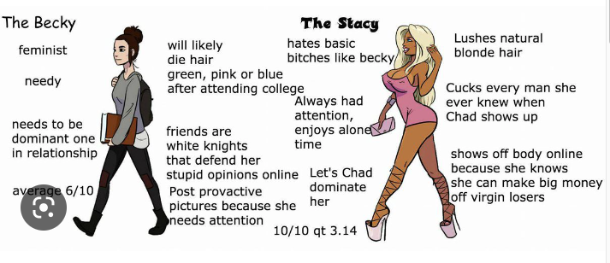
Involuntary Celibates (Incels)
Become dangerous when they buy into what they call the Black Pill: a violent political ideology promoted in online forums which defines their grievance of women refusing to have sex with them as a societal problem to which they should respond with violence or suicide.
The Black Pill ideology claims society, via feminism and gender equality, is rigged against men who lack the money, status, or physical attractiveness to enter romantic/sexual relationships with shallow women who are constantly “trading up”
The Black Pill divides attractive women into two groups: Stacey’s and Becky’s who are perceived as unavailable to them and "Chads” the Alpha men who these women sleep with.
The Black Pill claims 20 percent of good looking and successful men are getting 80 percent of women and good-looking women who discard less men and ignore the bottom 10 percent of men who become incels.
As they Black Pill, some incels turn to violence directed at good looking women and “Chads” – the alpha males whom they claim women prefer.

Slide 36
Incel Attacks and Slogans
Are Incels a supremacist and violent extremist group? Yes, when they totally buy into the Black Pill ideology, frustrated incels begin to feel entitled and demanding: they want to be able to have sex on demand with young, beautiful women believing that this is their natural right and when it doesn’t work out, they directed their anger inward, in suicide, or outward in mass killings.
First well-known attack was Elliot Rodger’s 2014 spree killing in Isla Vista, California. Before carrying out his attack, Rodger left a video and a manifesto-type autobiographical account detailing his “involuntary celibacy”.
Alek Minassian’s 2018 Toronto van attack,
the 2018 Tallahassee Yoga Studio shooting,
the 2020 Toronto erotic spa machete attack,
and the 2020 shooting at the Westgate Mall in Arizona, among others;
with a combined death toll of nearly 50 people

Slide 37

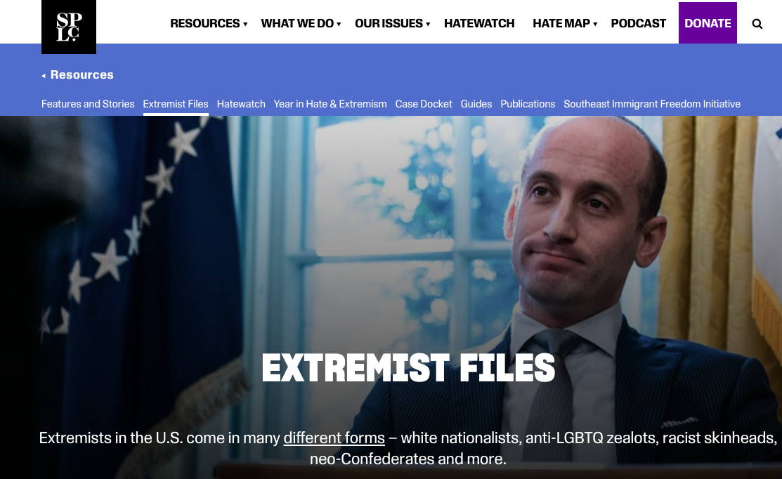
Resources to Understanding DVE Groups and Symbols
https://www.adl.org/hate-symbols
https://www.splcenter.org/fighting-hate/extremist-files

Slide 38
Recent Cases of Domestic Violent Extremism in the U.S.

Slide 39
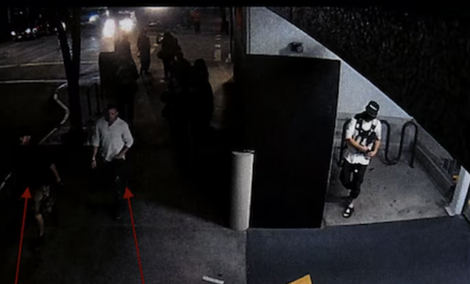
Antifa Murder of Patriot Prayer member - August 29, 2020: Portland, OR
Michael Reinoehl, a self-identified Antifa supporter, allegedly shot and killed Aaron Danielson, a member of the far-right group Patriot Prayer, in Portland, OR after a clash between George Floyd protesters and counter-protesters;
Reinoehl was shot by the U.S. Marshals five days later. Police often conflate the threat of Antifa. However, This was the first documented homicide by a self-identified anti-fascist in 26 years while white supremacist murdered 329 people in the same time period.
Police had seized a gun from Reinoehl during a July protest and he was given a citation for possessing a loaded gun in a public place, resisting arrest and interfering with police.
Police took a Walther 9mm semi-automatic handgun from Reinoehl. The citation was dropped by the Multnomah County District Attorney’s Office later in July, and Reinoehl spent no time behind bars.
Notes:
https://www.oregonlive.com/crime/2020/09/arrest-warrant-against-michael-reinoehl-for-2nd-degree-murder-unlawful-use-of-a-firearm-unsealed.html

Slide 40
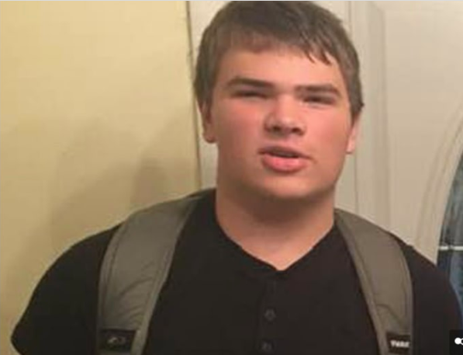
Peyton S. Gendron -May 14, 2022: Buffalo shooting, NY
Peyton S. Gendron, age 18, shot and killed ten people and injured three, all shoppers and employees at Tops supermarket.
All ten people who died were Black, as well as one of the injured victims.
Gendron livestreamed part of his attack on Twitch and also published a 180-page manifesto in which he referred to himself as an ethno-nationalist and reported believing in the white genocide and Great Replacement theories.

Slide 41
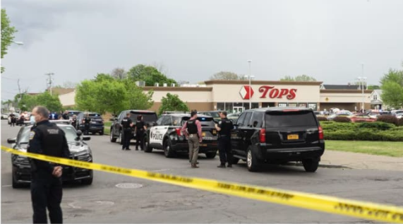
Buffalo Shooter – Psychological Perspective
Was a loner attending high school. Peyton contemplated the idea of suicide using the hunting rifle his father bought him but decided “that would make my parents feel like they killed me even more”.
In response to his teacher’s query: “What do you plan to do when you retire?”, Payton replied “Murder-suicide.”
New York State police visited the Gendron home. Despite his protests that it was all a joke, the 17-year-old who had long been viewed by classmates as a loner was questioned by state police and taken into custody and to a hospital for a psychiatric evaluation under a state mental health law.
The evaluation produced no immediate concerns, so he did not qualify under the red flag laws of New York state which bars people with a mental health diagnosis and deemed a threat to others from buying or owning a firearm.
He was released to his parents and was able to buy an assault rifle, an AR 15.
Months before his shooting spree he posted disturbing videos and admitted he had stabbed, beaten and decapitated a feral cat.
Wrote in his manifesto that he was bored during the pandemic and started watching and listening to white supremacist ideology on the internet.
His hero was Brenton Tarrant. a white supremacist who live-streamed himself murdering 51 Muslims at a mosque in Christchurch, New Zealand. Peyton carefully studied his attack to do it one better.
In his Manifesto chapter -“Weapons, Equipment, and Mentality of the Attacker,” he writes, “An attacker must first go through with an attack in their mind. They must plan everything they can.”
Peyton’s attack was meticulously planned ahead

Slide 42
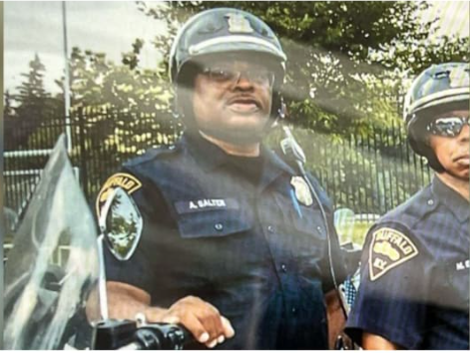
Peyton Gendron – Police Perspective
His plot started five months beforehand was intensely and carefully planned.
Peyton went to surveil the grocery store and got a speeding ticket on the way there.
Hid his weapons and gear all through the house. Wrote that he thought his parents were on to him..
Purchased and photographed his weaponry apparently in his home. He purchased a combat helmet, body armor, and a Go-Pro camera which he carefully mounted on the helmet.
A month before he wrote a goodbye letter to his family that he put in a drawer.
One of his victims was police officer Aaron Salter.

Slide 43
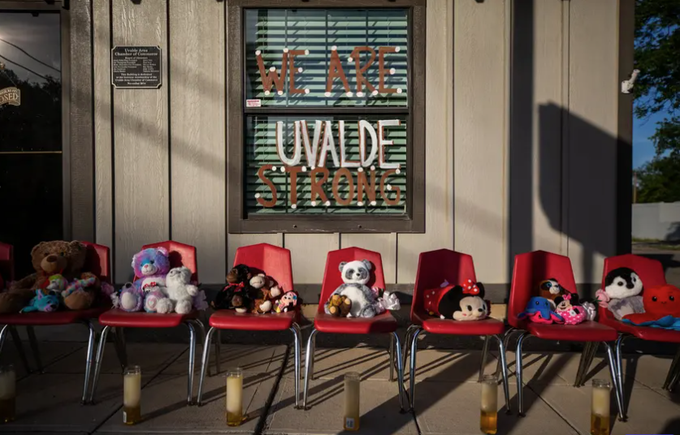
School Shooting -May 24, 2022: Uvalde, TX
Salvador Ramos, age 18, shot and killed 19 fourth grade students and two teachers at Robb Elementary School.
He had previously shot his grandmother in the face, severely wounding her, and also shot and wounded 14 other children and two police officers.
Domestic violent extremists discussed the shooting extensively online, with some praising Ramos and urging copycat attacks, and others calling the shooting a false flag operation aimed at instituting gun control measures.

Slide 44
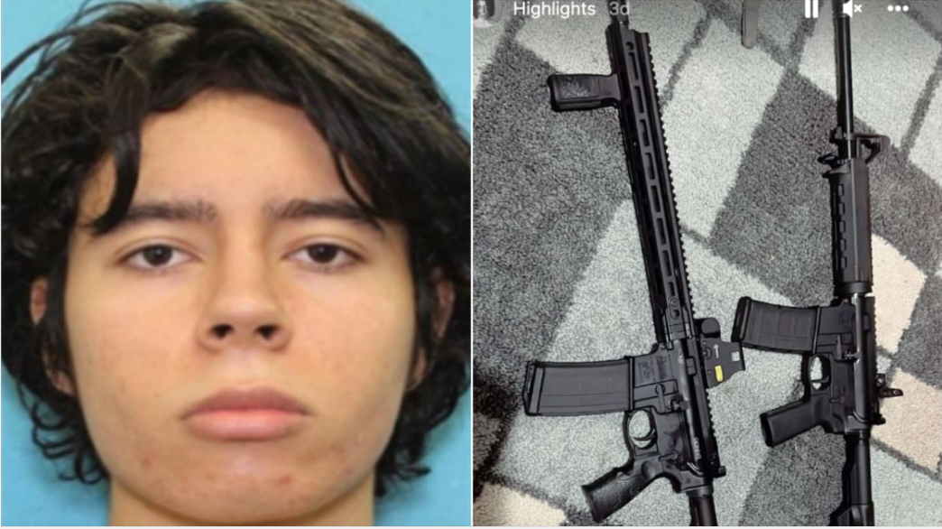
Salvador Ramos – 2022 Uvalde, TX School Shooting – Psychological Perspective
Salvador Ramos,
Mother struggled with drug abuse
Was bullied in fourth grade over his clothing, hair cut and stutter.
Flagged at school as “at risk” Had over 100 absences in the year in 2018
Possibly sexually assaulted by his mother’s boyfriend, reported to his mother but she didn’t believe him?
Wrote about challenges connecting with others or feeling empathy for them, saying he was “not human.” and searched to learn about sociopaths.
Wanted to be “famous”
Online, the report authors said, he started to show an interest in gore and violent sex, sometimes sharing videos and images of suicides and beheadings.
While playing online games, he became enraged and threatened others, especially female players, when he lost.
Notes:
https://www.texastribune.org/2022/07/17/uvalde-shooter-warnings-background/

Slide 45
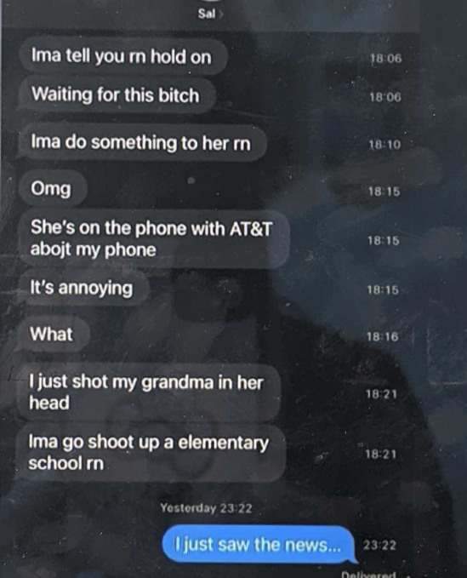
Salvador Ramos – 2022 Uvalde, TX School Shooting – Missed Signals
Told his girlfriend at the time that he wouldn’t live past 18, either because he would commit suicide or “wouldn’t live long,” she broke up with him in 2021 and he began harassing her.
A year before the Uvalde school massacre, he had already earned the nickname “school shooter” —among online gamers.
He was depressed and into gore, wearing all black and making over-the-top threats, especially toward women, who he terrorized with graphic descriptions of violence and rape. Ramos had previously posted violent threats online, including threats to kidnap and rape girls.
Played video games while quizzing a younger student about the class schedules
Collected news about the Buffalo shooting
Months before made ominous messages about “doing something” to his contacts
Told a girl in Germany
Amassed more than 5K in guns, ammo and gear in the weeks before
The quick succession of gun sales was reported to the Bureau of Alcohol, Tobacco, Firearms and Explosives, but it was not reported to local law enforcement. Only handgun purchases are required to be reported to local police.
The report concluded that "there apparently was no information actually known to local Uvalde law enforcement should have identified this attacker as a threat to any school campus" before the shooting occurred.
Notes:
https://www.texastribune.org/2022/07/17/uvalde-shooter-warnings-background/ https://www.npr.org/2022/07/17/1111945402/uvalde-shooter-warning-signs-report

Slide 46
Policing Plans for Action
Every officer knows what violent extremism is
Every officer knows what DVE groups are active in their area and the threat they pose to the community
Every officer can identify and knows where to find:
  Organizational dissemination plan for this information
  DVE groups
  DVE slogans and symbols
  DVE ideologies
  DVE conspiracy theories

Slide 47
Quiz

Slide 48
Thank You!
This project is funded by the U.S. Department of Homeland Security’s Center for Prevention Programs and Partnerships, opportunity number DHS-22-TTP-132-00-01”
Contact:
  Anne Speckhard: Anne.Speckhard@ICSVE.org
  ICSVE website www.ICSVE.org
  ICSVE Research Reports - https://www.icsve.org/publications/research-reports/
  ICSVE Training Events - https://www.icsve.org/news/icsve-events/
  ICSVE Training Resources - https://www.icsve.org/p-cve-training-resources/
  ICSVE YouTube Play lists - https://www.youtube.com/@ICSVE/playlists

