Slide 1

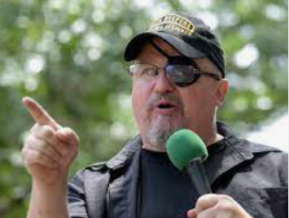
What to Do About Extremism When It Takes Root
Anne Speckhard, Ph.D.
Director, International Center for the Study of Violent Extremism

Slide 2
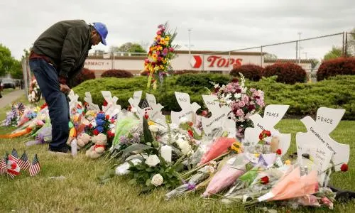
Police Responses to Terrorism and Violent Extremism ICSVE Training Outline
Monday: Understanding Ideologies and Groups: Focus on Domestic Groups
Tuesday: Understanding Ideologies and Groups: Focus on International Groups
Wednesday: How Extremists Enter Communities: Matching Vulnerabilities and Motivations with Extremism
Thursday: What to Do About Extremism When It Takes Root & Creating a Whole-of-Society, Public Health Systems-Based Response
Friday: Extremist Recruitment and Infiltration Practices in Law Enforcement

Slide 3
Pre-Quiz

Slide 4

Let’s talk Interagency Coordination as it is Crucial to Knowing What May be Coming Your Way

Slide 5
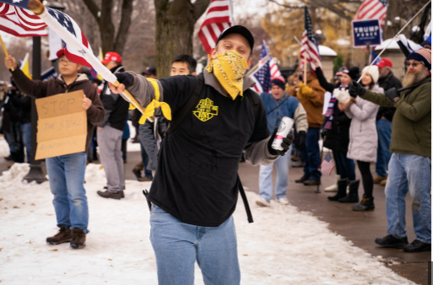
Why is Interagency Coordination Important?
Violent extremist groups exist across state borders and engage in activities which may fall under local, state, or federal jurisdiction
When protests happen in your community, do you know who might be driving or flying in to join or counter-protest?
  Example: Portland law enforcement stated that many of the most violent protesters were coming from outside of the city to incite violence.
  Proud Boys & Patriot Front often travel as does Antifa
Some violent extremist cases may have international ties, so involving federal law enforcement in such investigations may prove useful

Slide 6
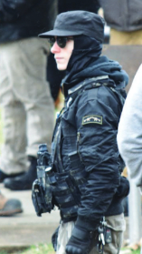
Church Attack for Drag Queen Story Hour – March 2023 - Ohio
Aimenn D. Penny, 20 years old, used a Molotov cocktail to firebomb the Community Church of Chesterland (CCC), in Ohio that planned to host a “Drag Queen Story Time,”
Penny was affiliated with “White Lives Matter.”
He was charged with one count of malicious use of explosive materials and one count of possessing a destructive device.
FBI reported finding a hand-written manifesto that contained ideological statements, a Nazi flag, a White Lives Matter of Ohio T-shirt, and other hateful memorabilia in Penny’s home, along with a gas mask, multiple rolls of blue painter’s tape, and gas cans.
Penny stated that he would have felt better if the Molotov cocktails were more effective and burned the entire church to the ground.
Notes:
https://www.wkyc.com/article/news/local/geauga-county/geauga-county-church-recovers-vandalism-prepares-protesters-drag-queen-story-hour/95-601381f3-7ff5-4346-b1d9-a01011b45adc, https://lawandcrime.com/high-profile/white-lives-matter-racist-firebombed-church-that-hosted-drag-brunch-feds/

Slide 7
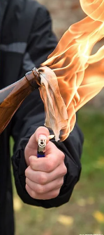
Church Attack for Drag Queen Story Hour – Ohio – Warning Signs
Penny earlier showed up to another drag queen event on March 11 in Alliance, Ohio, where members of White Lives Matter were carrying “swastika flags, shouting racial and homophobic slurs and ‘Heil Hitler’” and where he handed out anti-drag flyers. Antifa say he protested in Columbus 12/3/22
After his arrest for firebombing the church, Penny stated that he was trying to protect children and stop the drag show event,”
“In Penny’s opinion, African Americans were the ‘problem.’ Further, he wanted to educate everyone about their violence toward white Americans. Penny stated that he believed African Americans were solely responsible for the high crime rate across the country. Penny made it clear that he believes — and looks forward to — the civil war coming between races. Penny expressed his belief that the United States will not prosper until all the other races, or ‘weaknesses’ as he called them, are gone.”
Notes:
https://www.wkyc.com/article/news/local/geauga-county/geauga-county-church-recovers-vandalism-prepares-protesters-drag-queen-story-hour/95-601381f3-7ff5-4346-b1d9-a01011b45adc, https://www.wkyc.com/article/news/local/geauga-county/drag-queen-brunch-story-hour-geauga-county-church-police-urge-to-cancel-event/95-36a0ee9b-5d80-4f24-86f1-118baf99b7b8, https://www.justice.gov/opa/press-release/file/1577496/download?utm_medium=email&utm_source=govdelivery

Slide 8
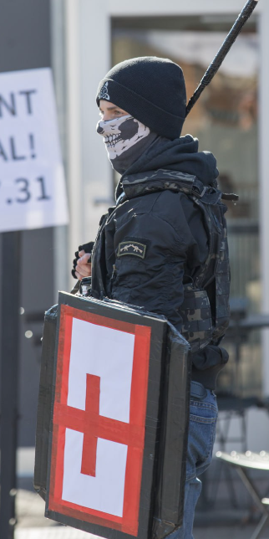
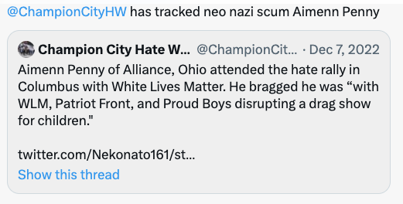
Church Attack for Drag Queen Story Hour – Ohio – Warning Signs
Alliance police say they saw Penny carrying a very large hunting knife and expandable baton, which weren’t concealed – in the March 11, 2023 protest.
Notes:
https://www.wkyc.com/article/news/local/geauga-county/geauga-county-church-recovers-vandalism-prepares-protesters-drag-queen-story-hour/95-601381f3-7ff5-4346-b1d9-a01011b45adc, https://www.wkyc.com/article/news/local/geauga-county/drag-queen-brunch-story-hour-geauga-county-church-police-urge-to-cancel-event/95-36a0ee9b-5d80-4f24-86f1-118baf99b7b8, https://www.justice.gov/opa/press-release/file/1577496/download?utm_medium=email&utm_source=govdelivery, https://mobile.twitter.com/ComradeOhio/status/1641959911100694529

Slide 9
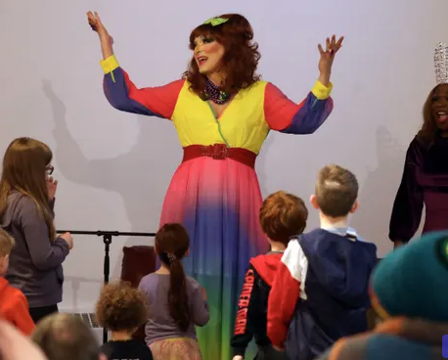
Interagency Coordination on the Drag Queen Story Hour Attack
Special Agent in Charge Gregory Nelsen of the FBI Cleveland Field Office said Penny's arrest was made possible through a collaborative effort between the FBI Cleveland Joint Terrorism Task Force and the Chester Township Police Department.
"The FBI leveraged its task force and its specialized resources to identify, locate and subsequently arrest the subject earlier today," Nelsen said. "We thank the collaborative work and strong partnership of the Chester Township Police and Lake and Geauga County local authorities who assisted."
Notes:
https://www.foxnews.com/us/ohio-man-attempted-burn-down-church-hosted-drag-queen-story-hour-fbi

Slide 10
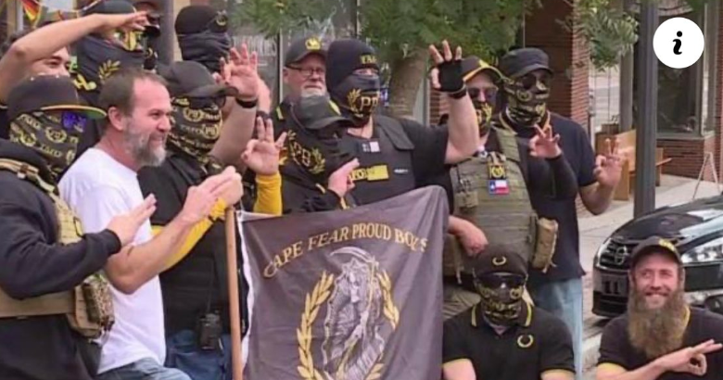
Church Attack for Drag Queen Story Hour - Policing Issues
Assistant Attorney General Matthew G. Olsen of the Justice Department: “It is the solemn duty of the Department of Justice to safeguard the right of all Americans to free expression, and I commend the work of law enforcement in this matter.”
Proud Boys, who travel from place to place, were gearing up to protest the next event. Chester Township Police Chief Craig Young sent out a post on Facebook recommending the event be cancelled.
"We implore police officials to turn their attention away from our private events and focus on keeping the hate groups away... Instead of asking us to hide, perhaps they could tell the hate groups not to come.”
Police officials were concerned about the expenditure to keep the LGBTQ community safe. “We ask, how can you justify denying an expenditure keeping the LGBTQ community safe? We understand these hate groups use financial terrorism as a tactic to force police agencies to take sides in situations like these; but choosing the side of the outside hate groups instead of members of this community they are sworn to protect sets a dangerous precedent for future targeted acts like these.”
Notes:
https://www.wkyc.com/article/news/local/geauga-county/geauga-county-church-recovers-vandalism-prepares-protesters-drag-queen-story-hour/95-601381f3-7ff5-4346-b1d9-a01011b45adc, https://www.wkyc.com/article/news/local/geauga-county/drag-queen-brunch-story-hour-geauga-county-church-police-urge-to-cancel-event/95-36a0ee9b-5d80-4f24-86f1-118baf99b7b8

Slide 11
Resources for Policing
Do you know what resources are available to you?
  Federal law enforcement support
  Online databases for tracking extremist and criminal activity
  Mental health services
  Community members who can help with referrals and interventions
    Teachers
    Clergy
    Community leaders
    Youth groups
    Martial Arts Leaders
    Gym and Paintball Clubs
    Doxxing
  Non-profits that support police and their families

Slide 12
Data Tracking
Who?
What?
When?
Why?

Slide 13
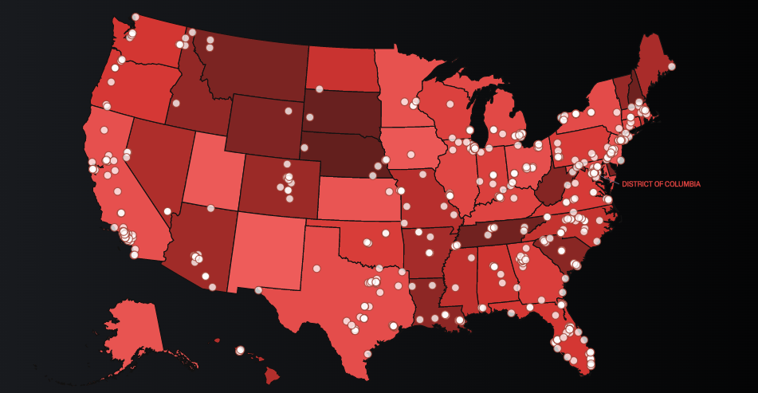
SPL – Hate Map
Notes:
https://www.splcenter.org/hate-map

Slide 14
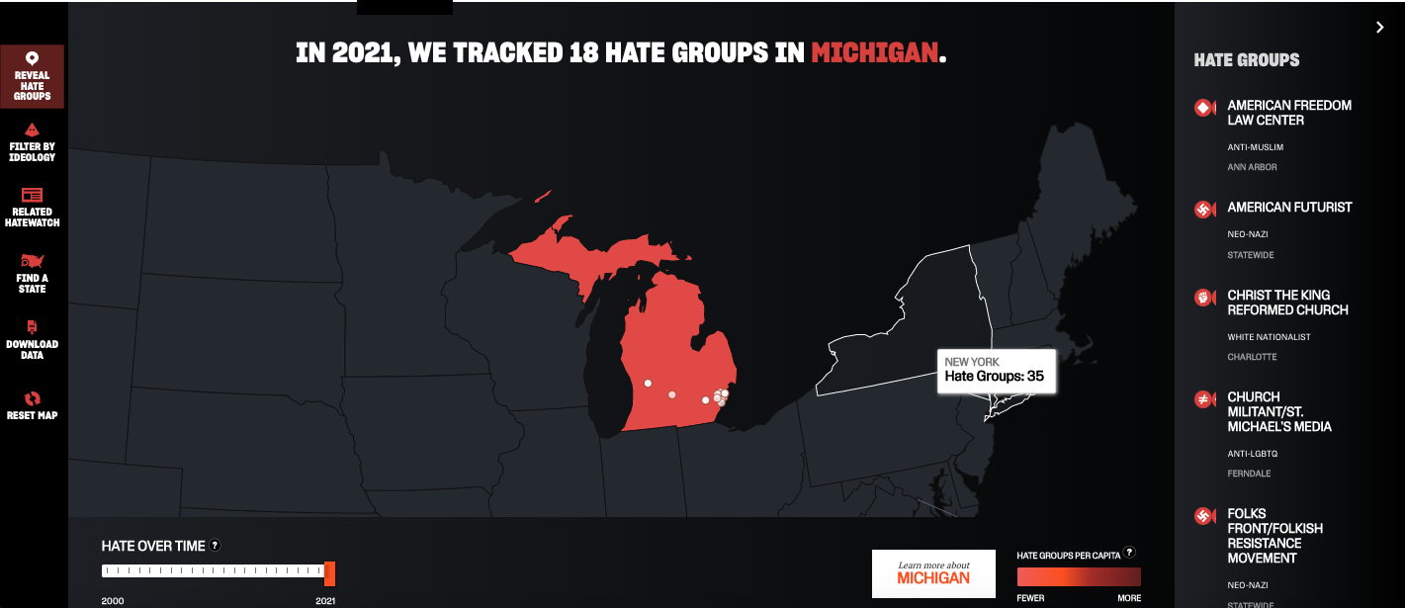
SPL Hate Map by State
https://www.splcenter.org/hate-map

Slide 15
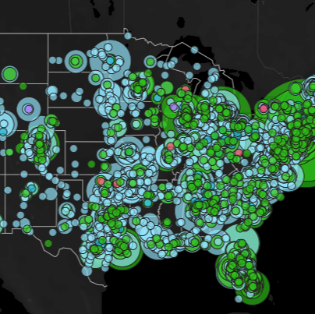
ADL HEAT Map
ADL H.E.A.T. Map™ (Hate, Extremism, Antisemitism, Terrorism) is the first-of-its-kind interactive and customizable map detailing specific incidents of hate, extremism, antisemitism and terrorism by state and nationwide. This interactive map lets you read details on specific incidents, better understand tactics extremists use, compare activity by type and/or state and access and download raw data.
Notes:
https://www.adl.org/resources/tools-to-track-hate/heat-map?gclid=EAIaIQobChMI_uHbrN-W_gIVwO_jBx0Tug49EAAYASABEgJvc_D_BwE

Slide 16
Policing Plans for Action
Consult the SPL Hate Map and the ADL Heat map and find out which groups are active in your area and what is going on regarding domestic violent extremism and terrorism in your community.
Reach out and establish and maintain inter-agency coordination – Proud Boys, Patriot Front, Antifa, etc. frequently travel to protests.
Establish and maintain a data-tracking system
  Assign a point person for tracking cases of violent extremism and begin a reporting system
  Every officer understands how to report and track data
Establish ties with informal reporters – teachers, social workers, fight clubs, gun shops, members of groups of concern…
Establish, advertise, and maintain an early warning system, making it clear that help will be provided
Every officer has community policing training to build trust

Slide 17
Post-Quiz

Slide 18
Thank You!
This project is funded by the U.S. Department of Homeland Security’s Center for Prevention Programs and Partnerships, opportunity number DHS-22-TTP-132-00-01”
Contact:
  Anne Speckhard: Anne.Speckhard@ICSVE.org
  ICSVE website www.ICSVE.org
  ICSVE Research Reports - https://www.icsve.org/publications/research-reports/
  ICSVE Training Events - https://www.icsve.org/news/icsve-events/
  ICSVE Training Resources - https://www.icsve.org/p-cve-training-resources/
  ICSVE YouTube Play lists - https://www.youtube.com/@ICSVE/playlists

