Slide 1
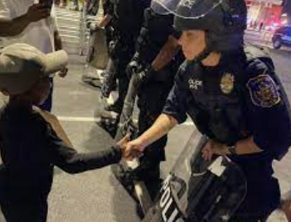

Creating a Whole-of-Society, Public Health Systems-Based Response
Anne Speckhard, Ph.D.
Director, International Center for the Study of Violent Extremism

Slide 2
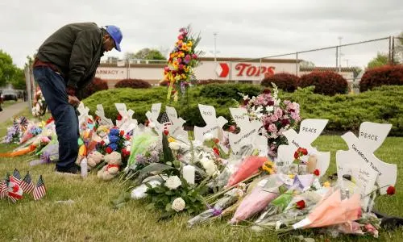
Police Responses to Terrorism and Violent Extremism ICSVE Training Outline
Monday: Understanding Ideologies and Groups: Focus on Domestic Groups
Tuesday: Understanding Ideologies and Groups: Focus on International Groups
Wednesday: How Extremists Enter Communities: Matching Vulnerabilities and Motivations with Extremism
Thursday: What to Do About Extremism When It Takes Root & Creating a Whole-of-Society, Public Health Systems-Based Response
Friday: Extremist Recruitment and Infiltration Practices in Law Enforcement

Slide 3
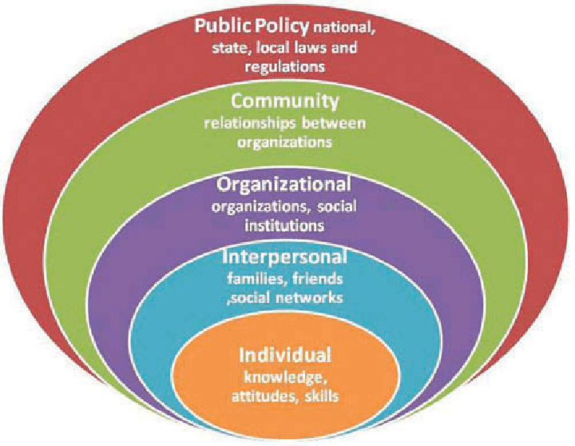
The Systemic Nature of Problems and Solutions

Slide 4
Pre-Quiz

Slide 5
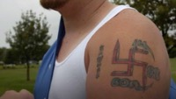
Notes:
Black People are Not our Friends https://www.youtube.com/watch?v=NpUwOmYmubM&list=PLqpy96DXqN-eNRvnqVAzMdcec9wOih0XW&index=7&ab_channel=ICSVE

Slide 6
Public Health Approaches to Preventing Targeted Violence
Define and monitor the problem
1
Identify risk and protective factors
2
Develop and test prevention strategies
3
Ensure widespread adoption
4
From Office of Justice Programs

Slide 7
Building a Community-Based Early Warning and Intervention System
Who is most likely to notice red flags?
Do they know what those red flags are?
Do they know who to contact about those red flags?
Do they know what will happen when they make contact?
Do they trust that those whom they contact will act fairly and justly?

Slide 8
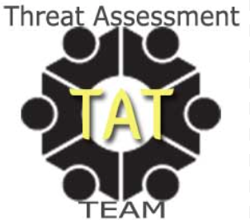
Establishing Effective, Whole-of-Society, Threat Assessment & Management Teams
Each team member is valuable and brings different skills to the table
Who should be included in a rapid-response team?
  Educators, school administrators, school board members
  Social services providers
    Housing
    Economic and employment services
    Healthcare
  Mental health providers
    Psychologists
    Social workers
    School counselors
  Faith-based organizations and religious leaders
  Parents, caregivers, and families
  Private sector partners

Slide 9
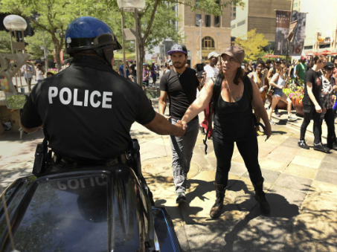
Building Trust with Police
Public safety is a team sport – law enforcement are key, but you cannot do it alone!
  Do those you need trust you enough to report these individuals without fear of repercussion or an overly punitive response?
Building trust with the community is fundamental to effective policing.
Showing respect and acting with fairness.
Giving the public a go-to person in the police force.
Starting and maintaining individual relationships.
Sound conduct by police improves community interactions, enhances communication, and promotes shared responsibility for addressing crime and disorder.
Trust in police has four dimensions: shared priorities, respectfulness, dependability and competency (Stoutland, 2001)

Slide 10
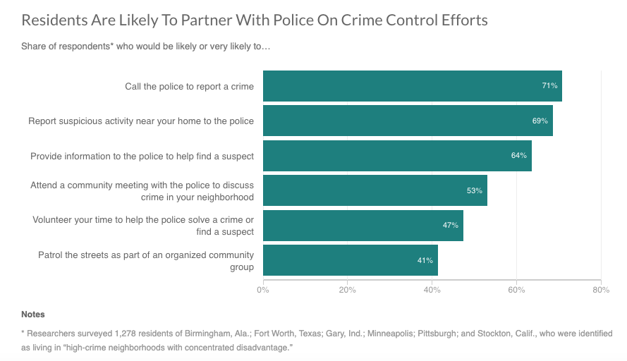
Urban Institute Survey finds residents in high-crime, high-poverty areas have a negative view of the police but have high respect for the law and are willing to work with law enforcement to make communities safer.
Notes:
https://www.npr.org/sections/codeswitch/2017/02/22/515820280/low-income-pocs-still-don-t-trust-the-police-but-would-work-with-them

Slide 11
Empowering Communities
Is anyone in your force known in vulnerable communities for being helpful? Someone they can always trust to talk with? Do you get informal reporting? Why not?
Do you have a formal mechanism for community members to report violent extremist groups or incidents of violent extremism?
  Do community members know about this mechanism?
  How is it advertised?
  Is it easy to navigate?
  Is it anonymous?
Example: www.protect.dc.gov

Slide 12
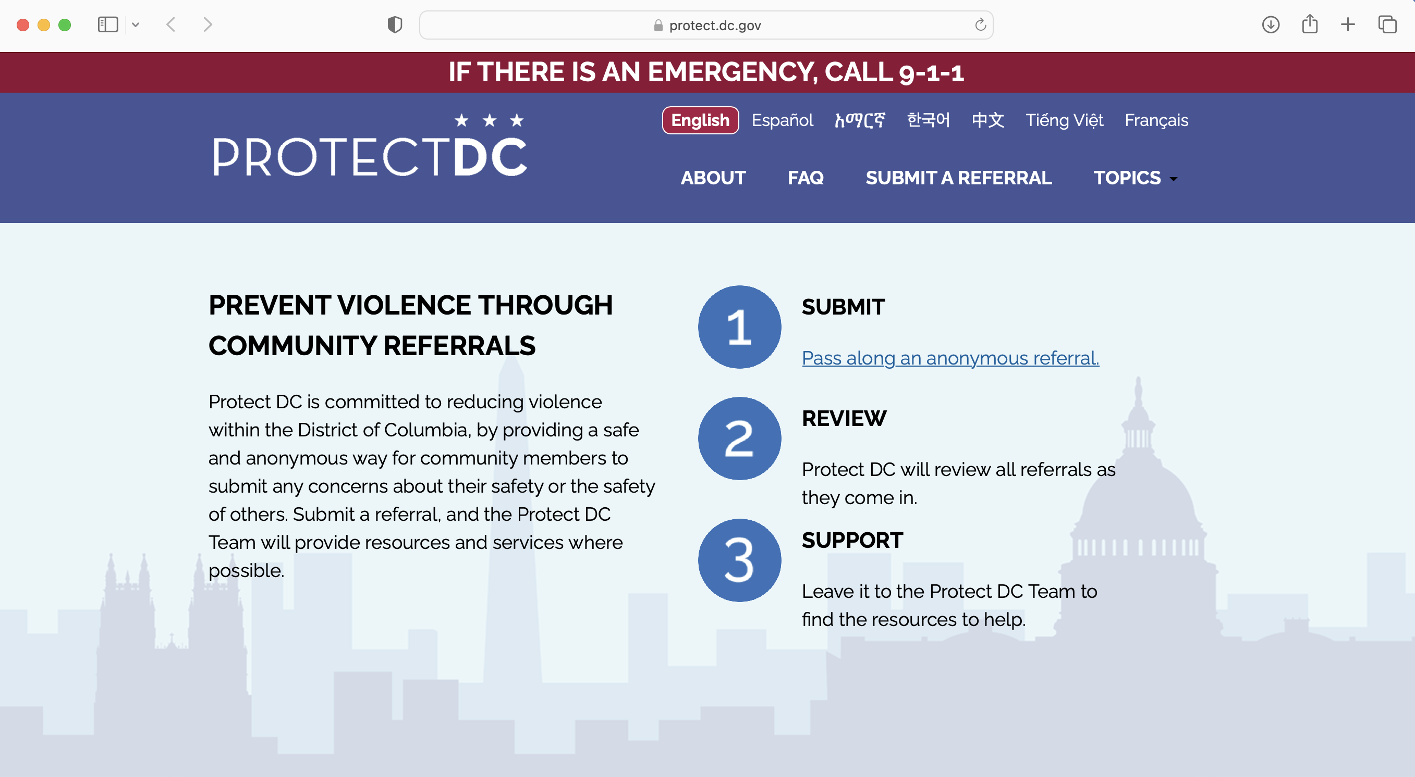
Notes:
https://protect.dc.gov/

Slide 13

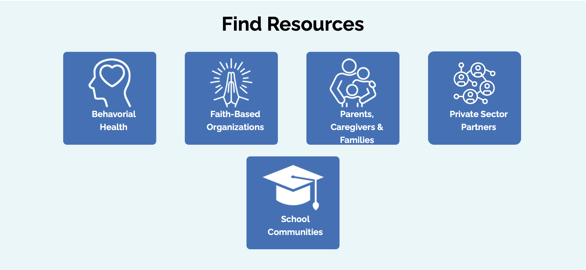
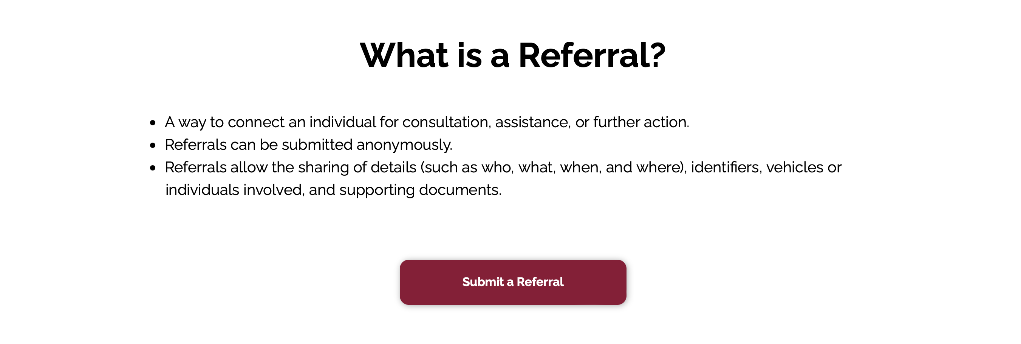

Slide 14
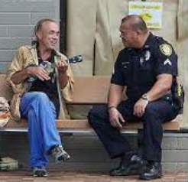
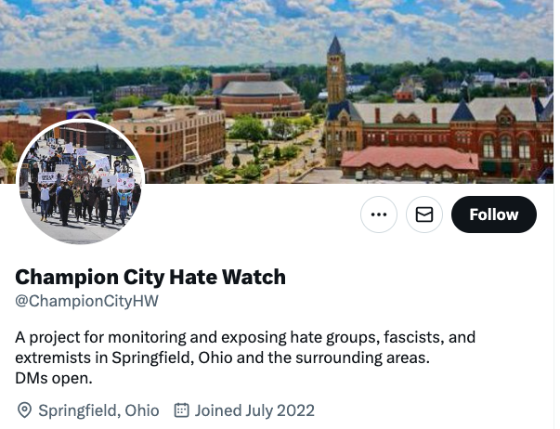
Community Networks
Who in your community is most able to detect radical groups and individuals who are becoming radicalized?
Who in your community can prevent radicalization to violent extremism?
  Do they trust you enough to include you in their work?
  Do they see you helping or harming?
Who in your community is working to counter radicalization and intervene with radicalized individuals?
  Do they trust you enough to provide germane information that will aid investigations?
Who and where do extremists like to hang out/with, can you win their trust?

Slide 15
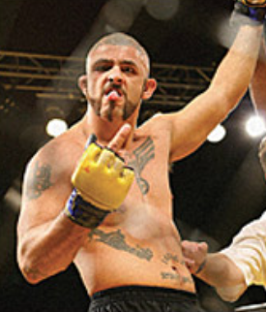
Mixed Martial Arts Clubs & Other Possible Extremist Breeding GroundsPolicing
Do you know your local Mixed Martial Arts clubs and what’s going on there? Your gun shop owners? Paintball clubs…
Melvin "Man-o-war" Costa - one of the top MMA fighters in the U.S. in 2008
Has a Nazi eagle and swastika tattooed across his chest
"A swastika, as far as I hold it true to my own, it stands for the purity of my people's blood," Costa told leading MMA sportswriter Sam Caplan last October. "I do believe in the purity, security, and the survival of the white race. … When I come down that [fighter entrance] ramp and people see me, they know I'm white power."

Slide 16

Resources for Establishing Effective, Whole-of-Society, Threat Assessment & Management Teams
  NTER National Threat Evaluation and Reporting Office​ | Homeland Security (dhs.gov)
  NTAC United States Secret Service
  NABITA NABITA - National Association for Behavioral Intervention and Threat Assessment
  ATAP Association of Threat Assessment Professionals (atapworldwide.org)
  Some CP3 Regional Prevention Coordinators are also equipped to provide threat assessment trainings to local communities. Please reach out to cp3field@hq.dhs.gov for more information and you can also find field resources can be found on: Center for Prevention Programs and Partnerships | Homeland Security (dhs.gov)

Slide 17

Notes:
The White Race is Supreme https://www.youtube.com/watch?v=SI4EnD2wdHY&list=PLqpy96DXqN-eNRvnqVAzMdcec9wOih0XW&index=11&ab_channel=ICSVE

Slide 18

McCain Institute Prevention Practioners Network
Notes:
https://www.mccaininstitute.org/programs/preventing-targeted-violence/prevention-practitioners-network/

Slide 19

Notes:
My White Heritage https://www.youtube.com/watch?v=CyUZPrk5_64&list=PLqpy96DXqN-eNRvnqVAzMdcec9wOih0XW&index=33&ab_channel=ICSVE

Slide 20

Parents for Peace Intervention Hotline
Notes:
https://www.parents4peace.org/helpline-and-intervention/

Slide 21
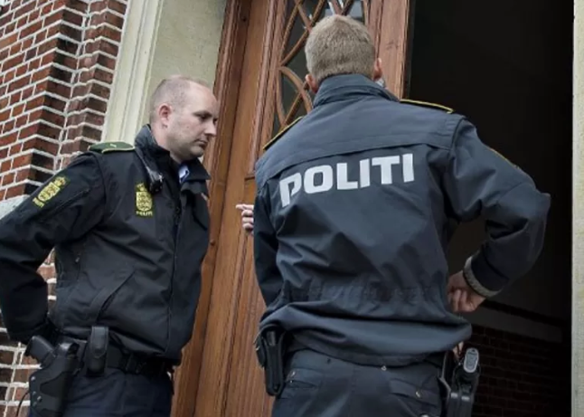
Community Policing and Violent Extremism: The Aarhus Model
Three main characteristics:
  Close and flexible cooperation among several already existing institutions and authorities working with exposed and vulnerable young people
  Inclusion
  Scientific foundation
Specific elements:
  InfoHouse – where to send information about possible radicalization to police
  Mentoring – mentors recruited with an eye toward needs of vulnerable people
  Workshops – held for K-12 students and teachers
  Parents Network
  Dialogues – especially with marginalized communities
  Exit program – includes mentoring
  Education and supervision of staff

Slide 22
Community Policing and Violent Extremism: The Aarhus Model
General population intervention:
Raises awareness of professionals and the public
Achieved via briefings and workshops for professionals and teaching institutions.
Entails collaboration with local communities.
Involves respectful and assertive dialogue with mosques, fight clubs, cultural associations and other major players in local communities.
Individual intervention:
First-line staff of the Task Force carry out risk evaluations of individuals and groups.
Professional staff are counseled on dealing with cases linked to radicalization.
Counseling is provided for individuals and families in cases related to radicalization.
Mentoring is provided for individuals at risk of radicalization or involved with violent extremism.
Contingency plans are made for extremists and their families.
Exit programs are set up for individuals involved in violent extremist environments.

Slide 23
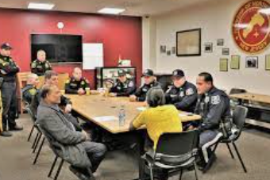
Creating a Whole of Society Public Health Systems Response -Policing Plans for Action
Identify community resources and experts
Establish a community task force to convene on specific cases
Every officer knows the experts and task force members
Develop a community outreach & education plan
Build trust in the community.

Slide 24
Post-Quiz

Slide 25
Thank You!
This project is funded by the U.S. Department of Homeland Security’s Center for Prevention Programs and Partnerships, opportunity number DHS-22-TTP-132-00-01”
Contact:
  Anne Speckhard: Anne.Speckhard@ICSVE.org
  ICSVE website www.ICSVE.org
  ICSVE Research Reports - https://www.icsve.org/publications/research-reports/
  ICSVE Training Events - https://www.icsve.org/news/icsve-events/
  ICSVE Training Resources - https://www.icsve.org/p-cve-training-resources/
  ICSVE YouTube Play lists - https://www.youtube.com/@ICSVE/playlists

