Slide 1


Extremist Recruitment and Infiltration Practices in Law Enforcement
Anne Speckhard, Ph.D.
Director, International Center for the Study of Violent Extremism

Slide 2
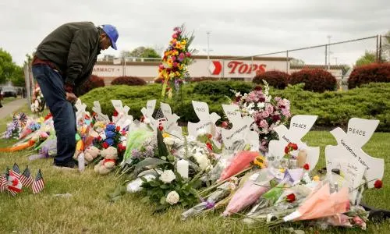
Police Responses to Terrorism and Violent Extremism ICSVE Training Outline
Monday: Understanding Ideologies and Groups: Focus on Domestic Groups
Tuesday: Understanding Ideologies and Groups: Focus on International Groups
Wednesday: How Extremists Enter Communities: Matching Vulnerabilities and Motivations with Extremism
Thursday: What to Do About Extremism When It Takes Root & Creating a Whole-of-Society, Public Health Systems-Based Response
Friday: Extremist Recruitment and Infiltration Practices in Law Enforcement

Slide 3
Pre- Quiz

Slide 4
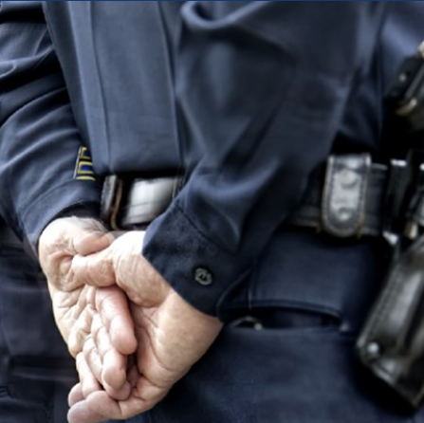
Extremism in Policing
Extremists – and their beliefs – have made their way into the ranks of law enforcement and the corrections sector nationwide.
The actual numbers are impossible to assess but we know that 5 of those arrested for storming the Capitol building on January 6 were active law enforcement officers
The ADL report includes members of law enforcement who are associated with or showed support for established extremist movements or groups during the past 10 years.
ADL found that when extremists exist in the police - anti-government and white supremacist beliefs are the most commonly held extremist beliefs
Three Percenters, Oath Keepers were most common but also included sovereign citizens.
Klan, white supremacists, Neo Nazis, less so, older trend
Q-Anon, Proud Boys new trends
Notes:
https://www.adl.org/resources/report/extremism-american-law-enforcement-far-greater-transparency-accountability-needed

Slide 5

Oath Keepers Data Leak
As of August 8, 2022, ADL’s Center on Extremism has identified 373 individuals in the Oath Keepers database who are believed to be currently serving in law enforcement agencies across the country.
Among these 373 law enforcement employees, they were holding a variety of positions, including officers, detectives, sergeants, lieutenants and captains.
Also identified individuals believed to be currently holding senior leadership positions within their respective agencies, including at least ten chiefs of police and eleven sheriffs.
Notes:
https://www.adl.org/resources/report/oath-keepers-data-leak-unmasking-extremism-public-life

Slide 6
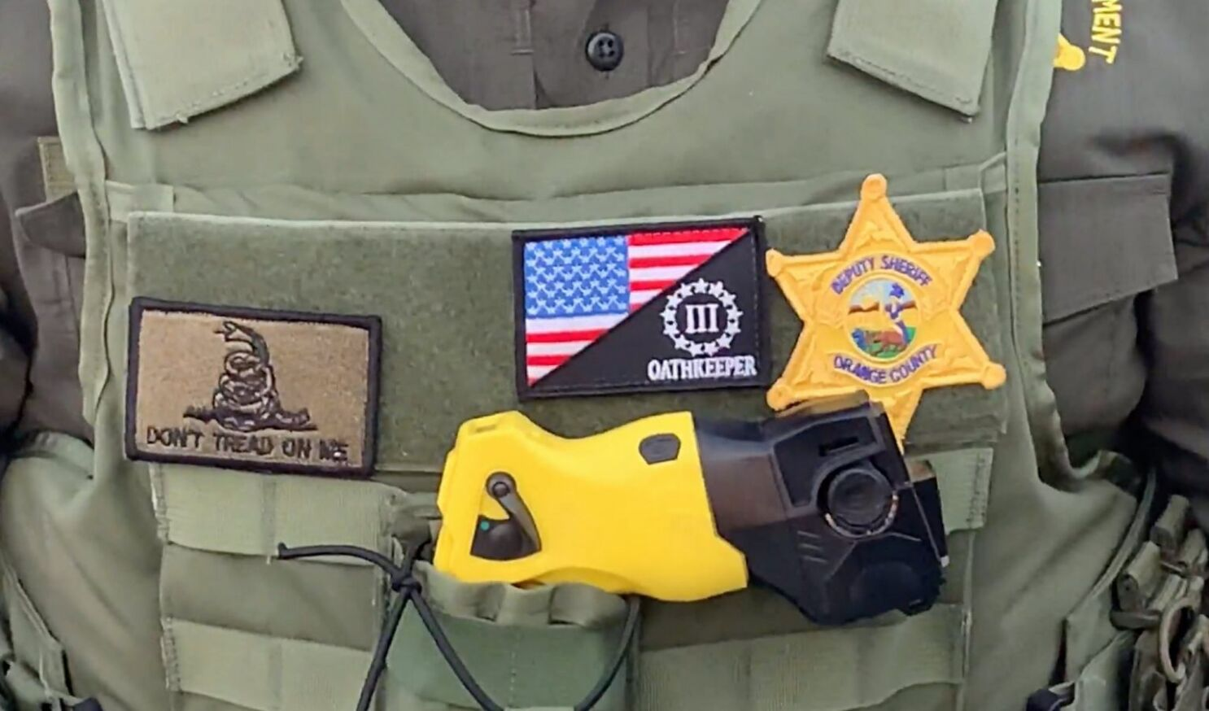
Why Do Violent Extremists Want Law Enforcement to Join Them?
Law enforcement officers have:
  Access to and training with weapons
  Access to hard targets for insider attacks
Law enforcement members of violent extremist groups can:
  Increase discipline and structure within the group
  Provide group members with weapons and tactical training
  Lend the group legitimacy and an air of patriotism
  Recruit others, including fellow law enforcement officers
  Help in a future government takeover and/or race war

Slide 7
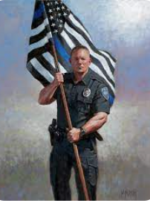
Why Do Law Enforcement Officers Join Violent Extremist Groups?
Belonging, purpose, dignity
Personal significance and recognition
Pursuit of the “noble cause” and (misguided) sense of patriotism
Outright racism
For former members of law enforcement:
  Camaraderie
  Rank structure
  Discipline
  Environment conducive to posttraumatic stress symptoms
Notes:
For police and their family members the thin blue line stands for solidarity and pride within a dangerous profession and as a means to honour fallen officers but after Black Lives matter protests it has become tainted and is seen as racist, offensive and a symbol of an us v. them mentality. a potent symbol of the ties between right-wing extremism and American law enforcement.

Slide 8

Notes:
Let’s Have a Racial War: https://www.youtube.com/watch?v=1_Egs_pahMc&list=PLqpy96DXqN-eNRvnqVAzMdcec9wOih0XW&index=20&ab_channel=ICSVE

Slide 9
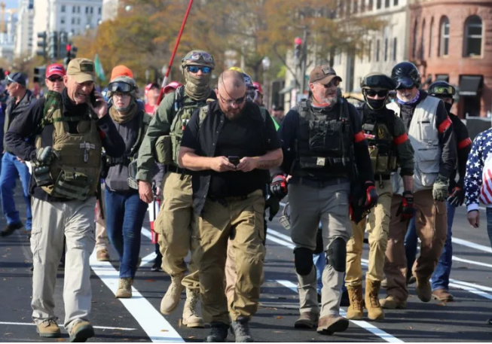
Preventing and Countering Violent Extremist Recruitment and Infiltration of Law Enforcement
Policy
Recruitment
Oversight
Internal Reporting
External Reporting
Intervention or Termination

Slide 10

Prevention – Create and Disseminate Clear Policies
Identify the groups active in your area
Create a policy with clear guidelines prohibiting membership in violent extremist groups – generally and by names.
Circulate this policy widely among the force, on the website and social media to the community and encourage internal and external reporting of violations
Develop an intervention and termination policy and adhere to it fairly.

Slide 11
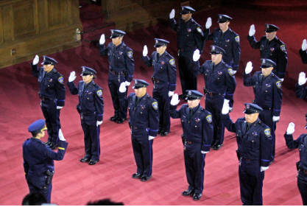
Policy – The Police Officer Oath
“On my honor, I will never betray my integrity, my character or the public trust. I will treat all individuals with dignity and respect and ensure that my actions are dedicated to ensuring the safety of my community and the preservation of human life. I will always have the courage to hold myself and others accountable for our actions. I will always maintain the highest ethical standards and uphold the values of my community and the agency I serve.”

Slide 12
Prevention: Good Recruitment Practices
Know the groups operating in your area and on the internet, as well as their ideologies and associated symbols
1
Keep these in mind when interviewing potential hires!
2
As laws allow, check social media accounts of potential new hires and cadets and home visits/neighborhood background checks, notice tattoos
3
Make clear in recruiting materials that membership in such groups is not tolerated
4

Slide 13

Countering: Good Monitoring Practices
As local laws allow, regularly check employees’ social media accounts with an eye toward symbols and language indicative of membership in a violent extremist group
Be aware of behavioral changes indicative of membership in a violent extremist group

Slide 14

Countering: Reporting
Establish a protocol by which officers or civilian department employees can report incidences of violent extremist behavior
Do they trust that the person they report will be treated fairly?
  Do they know what will happen to the person they report?
Do they trust that they will not be retaliated against for reporting?

Slide 15
Countering: Community Feedback
Establish a protocol by which community members can report incidences of violent extremist behavior or group membership of officers
This requires building trust first!
Do community members believe that you will respond appropriately to such reports?
Do community members trust that law enforcement will not retaliate against them for reporting?
Public safety is a team sport, and if community members are going to work with you, they need to trust that you all play on the same team

Slide 16

Fire, Sanction or Rehabilitate?
ADL report on extremism in police forces states: “Additionally, of the officers exposed as extremists in our research,
Equal numbers were forced out of their jobs as were allowed to keep their jobs or reassigned with full pay.
In at least two cases, officers terminated for extremism were rehired by another agency, and
at least one officer who resigned amidst accusations of extremism was hired by another agency.
Notes:
https://www.adl.org/resources/report/extremism-american-law-enforcement-far-greater-transparency-accountability-needed

Slide 17
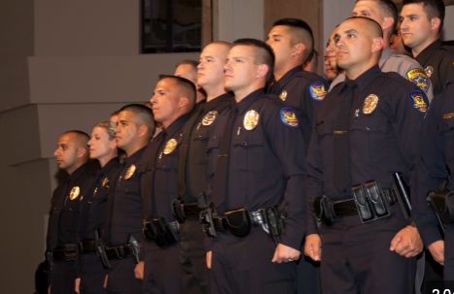
Countering: Zero Tolerance Policies
Zero tolerance policies are risky!
  Are you sending an individual with weapons training and a newfound anti-government grievance out into the community or to be hired by another law enforcement department?
But not firing a violent extremist within your department also sends a dangerous message to other officers and to the community
Not-quite zero tolerance is not the same thing as tolerance…

Slide 18

A Middle-Ground Solution
One strike, zero tolerance policies may not be the best approach
Neither is complete tolerance of such behavior
A Middle-Ground Approach:
  Create an effective reporting system through which officers, civilian employees, and community members can report violent extremist behavior among officers without fear of retaliation
  Investigate the allegation
  Offer the officer an opportunity to receive counseling and change their behavior
  Release the officer if they refuse or do not cooperate with such remedies – and warn future employers of the reason they left your department

Slide 19

Policing Plans for Action
Identify and know the groups active in your area
Develop a recruitment protocol – including checking social media and home checks as state law/department policy allows.
Establish clear policy guidelines forbidding membership in such groups.
Establish a social media policy reminding LE they are representing their state and local community
Regularly monitor your force, news stories, social media reports, and review their social media posts as state law/dept policy allows
Establish Establish a reporting system for officers and civilian department employees and community members including reporting social media concerns.
Establish a policy monitoring use of department equipment.
Every officer knows the policy regarding violent extremist behavior, membership and support for violent extremism.

Slide 20
Post-Quiz

Slide 21
Thank You!
This project is funded by the U.S. Department of Homeland Security’s Center for Prevention Programs and Partnerships, opportunity number DHS-22-TTP-132-00-01”
Contact:
  Anne Speckhard: Anne.Speckhard@ICSVE.org
  ICSVE website www.ICSVE.org
  ICSVE Research Reports - https://www.icsve.org/publications/research-reports/
  ICSVE Training Events - https://www.icsve.org/news/icsve-events/
  ICSVE Training Resources - https://www.icsve.org/p-cve-training-resources/
  ICSVE YouTube Play lists - https://www.youtube.com/@ICSVE/playlists

